Slide 1

Transportation Dataset Analysis 3rd June 2020 Barcelona

Slide 2


Our Team
Felipe Hayashi
Sanders Roos
Data Analyst Wannabe, data-driven and creative in the face of uncertainty.
Energy Engineer,
Want to contribute in the energy transition

Slide 3

Agenda
1 – Executive Summary
2 – Data sources
3 – Data Wrangling
4 – Main Insights
5 – Unanswered Questions
6 – Main learnings

Slide 4





1 - Data Sources
Executive
Summary
2 - Data Wrangling
Our main goal is to practice a thorough Data-Analysis workflow, which involves:
3 - Insights
4 - Identifying Challenges/Next Steps
5 - Learn!

Slide 5

1 - Data Sources
Dataset: Transportation related accidents in Barcelona
Source: https://opendata-ajuntament.barcelona.cat/
Historical Data: 2016 and 2017
Numerical Data: Accidents, Victims, Light Injuries, Serious Injuries, Deaths
Categorical data: Neighborhood, District, Time of the day(ordinal)
Dataset: Motorbikes registered in Barcelona
Source: https://opendata-ajuntament.barcelona.cat/
Historical Data: 2016 and 2017
Numerical Data: Number of motorbikes registered
Categorical data: Neighborhood, District, displacement capacity(cc)
Fuente: Observatorio Sectorial DBK

Slide 6
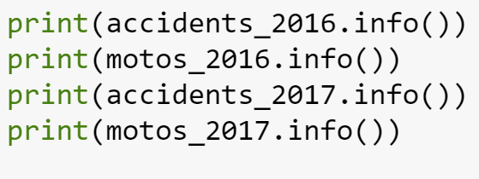
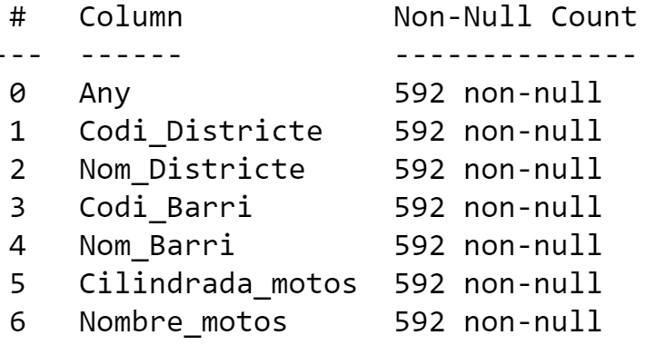
2 – Data Wrangling
DATA CLEANING:
Fortunately the data had no empty cells
On the other hand it was necessary to translate columns and values to English
GROUPING & AGGREGATION:
We used grouping for the Accidents Dataset by “District”, our objective was was to aggregate data to subgroups large sample size in order to remain representative
Alternatively for the Motorbikes we used the “pivot_table” function in order to “one-hot code” the bike potency(cc) category into numbers that could be aggregated by “District”

Slide 7
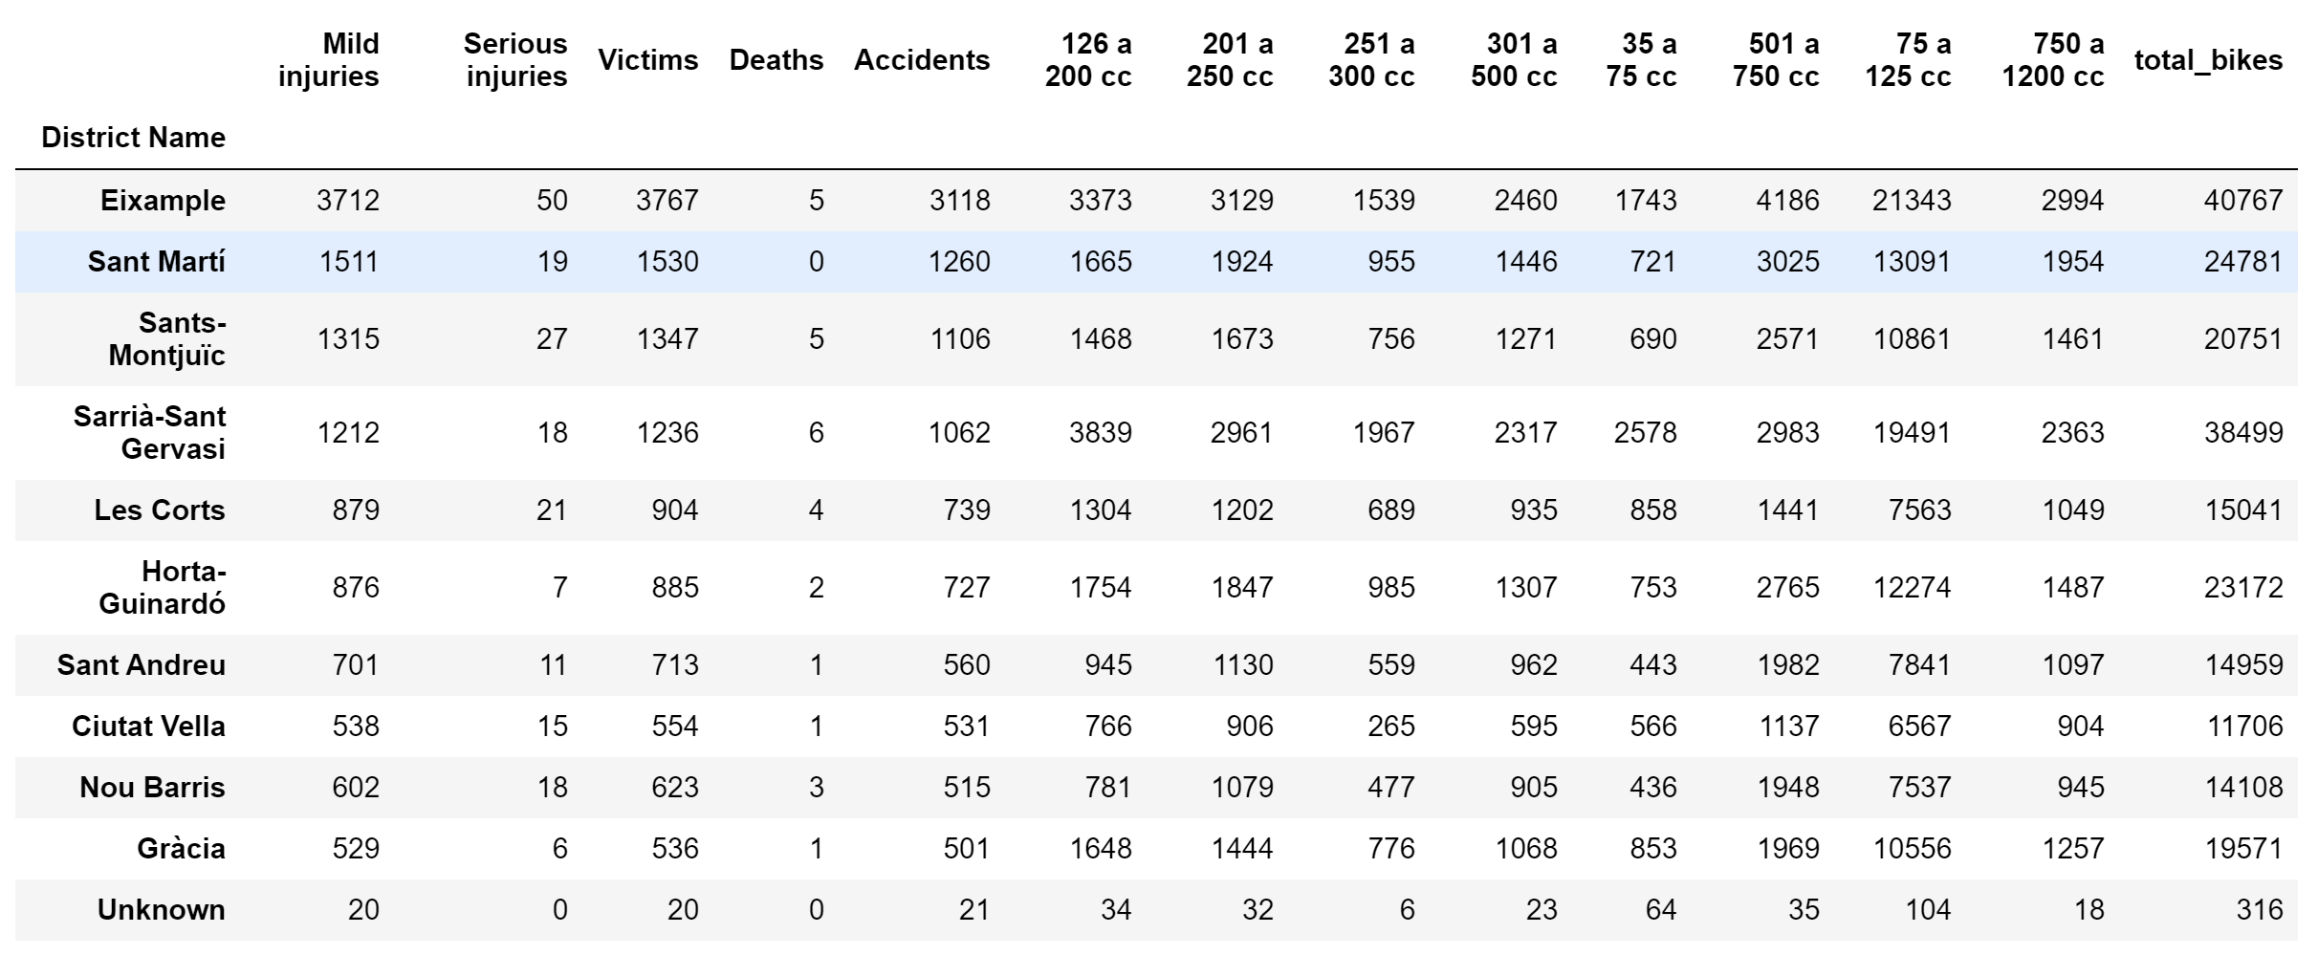
3 – Insights (1/3)
The Result was the Following Table*
Questions raised:
Do the total number of bikes has influence on the number of accidents?
Do they power/size of the bike correlates with accidents? What about deaths?
Hypothesis: We assumed for the purpose of the analysis that the Motorbikes registered to a district is representative of the number of bikes actively cruising in that area during any given day (No seasonality)
*2016 Dataset

Slide 8

3 – Insights (2/3)
The Result was the Following Table*
Accidents
Deaths
1st
Barcelona
Barcelona
2nd
Vizcaya
Lisboa
3rd
Cádiz
Valencia
4th
Castellon
Madrid
4th
Highest Correlation
%
%
Lowest Correlation
%
%
*2016 Dataset

Slide 9
3 – Insights (3/3)
The Result was the Following Table*
M1
M2
1st
Barcelona
Barcelona
2nd
Vizcaya
Lisboa
3rd
Cádiz
Valencia
Castellon
Madrid
4th
Highest Correlation
1st (69MM)
2nd (23.8MM)
Lowest
1st (32 agents)
4th (7 agents)

Slide 10

Insights 2016-2017
Analysis 3|4
Hypothesis
Comparison of motorcycle data and accidents in Barcelona
Increase/Decrease of accidents per neighborhood
Correlation between rate of accidents and growth rate of motorcycles per type
Why Ciutat Vella?
More vehicles
More tourists
Density of citizens
Why < 75 cc?
Reckless youth (like Pol)
Most affordable type
Results
-
District
Motorbike
1st
2nd
Ciutat Vella
Fins a 75 cc
3rd
Sant Andreu
501 a 750 cc
Sant Martí
75 a 125 cc
4th
301 a 500 cc
Gràcia
Highest
13 %
52.2%
Lowest
-2.85%
25%

Slide 11

Sales Ranking by Province
Content x 3|4
Considering sales-to-agent ratio, M1 and M2 is the most relevant segment while M3 and M4 are under-performers.
GAS4ALL notably has a weak presence of M1 segment in Madrid (1.3MM) appearing only 19th in the ranking for that segment.
M1
M2
M3
M4
1st
Barcelona
Barcelona
Madrid
Barcelona
2nd
Vizcaya
Lisboa
Barcelona
Madrid
3rd
Cádiz
Valencia
Valencia
Lisboa
4th
Castellon
Madrid
Vizcaya
Astúrias
Iberia Sales Ranking
1st (69MM)
2nd (23.8MM)
4th (8MM)
3rd (12.5MM)
Sales Agent Ranking
1st (32 agents)
4th (7 agents)
3rd (12 agents)
2nd (23 agents)

Slide 12
Challenges | Caused by | Learnings
Lose overview (Jupyter Notebook) | 4 datasets, four different parts | Organize Notebook with Markdown
Repeat entire code because of mistake | Wrong expectation of meaning result | More time to plan before code

Slide 13
Performance Comparison
Content x 2|4
Sales
Avg. Ticket / Client
M1 is the most prolific market for the company, with clients who have an average ticket of 41,119 €. M1 accounts for 20% of the client base, who are responsible for 61% of sales.
M4, with 61% of total clients in this market, only made 11% of the sales of the company.

Slide 14
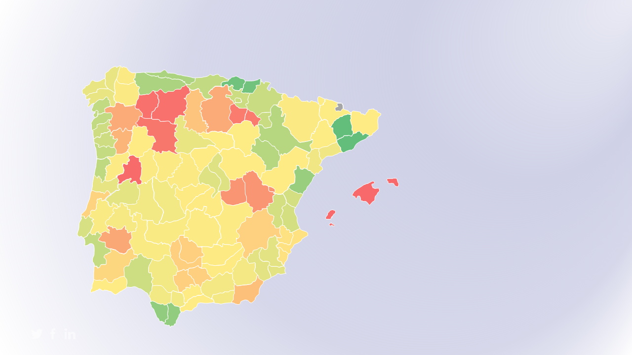
Analysis 4|4
Conclusion/M1 Current Situation

Slide 15
Analysis 4|4
Conclusion/M1 Current Situation
Right Place, Right Time
Strong sales coverage where
the sweet spots of valuable clients are.
Geographic Diversity
Considering sales-centric driven
nature of the industry, diversified
locations throughout Iberia.
Can´t have it all
Impossible to be physically present everywhere, forfeiting significant revenues and overstretching salesforce.
Overload
Many of the Work Centers have more clients per salesperson
than what is considered optimal.
On the other hand, M3 is overcapacity and M4 has too much workforce compared to clients.

Slide 16
Main Actions
M1 Sales Optimization 1|5
Rearrange/Hire Salesforce according to demand. Check availability from other segments salesforce and also value of sales people for them
Evaluate Impact of opening up new WorkCentre's to cater to unattended market.
Evaluate Fixed Cost vs Variable Cost
Respect existent customer allocation by work center assuming it respects the maximum distance covered by sales agent
Consider 11 months of activity / year
Defined a maximum of number of 54 customers / sales agent for the market M1
/
/
/
200
11
3
54
working days
months / year
visits / client
clients / sales agent

Slide 17
New Market Distribution
M1 Sales Optimization 2|5
Old M1 Capacity Utilization
(MAX)
New M1 Capacity Utilization
(MAX)
M1 – €1,6MM
( 42 sales agents )
169%
89%
M2 - €1,5MM
( 15 sales agents )
Every sales agent was attending 37 more clients than the maximum allowance.
All work centers have sufficient agents to visit all clients in their jurisdiction
M4 – €1,2MM
( 10 sales agents )
Old M1 Capacity Utilization
(AVG)
New M1 Capacity Utilization
(AVG)
97%
71%
M3 – €1,2 MM
( 7 sales agents )
The number of sales agents is proportional to clients but insufficient to fulfill the maximum distance requirement
Increasing the number of sales agents from 32 to 42 allows geographical coverage with space for growth.

Slide 18
Implementation Plan
M1 Sales Optimization 3|5
Define – What will be improved?
Measure – What impacts it?
Sales & Market Coverage
Sales Force visits to high performing clients.
Analyze – Why?
Improve – How can we improve?
Improve client experience and resource allocation.
Change organizational structure to prioritize best clients.
Control – Keeping high standard
Monitor - new variables
Measure and re-evaluate results refining the model and drive better actions
Strive for excellence incorporating new sales tools and watching competition efforts.

Slide 19
Implementation Plan
M1 Sales Optimization 4|5
Phase 4
IMPROVE
Once the goals and most impactful variables have been defined, take action to promote the necessary change.
Steps
Tools
Implement geographic reallocation
Communicate to clients about new sales rep and new structure.
Statistical approach to allocate resources (personnel).
Clear communication to sales team.

Slide 20
Implementation Plan
M1 Sales Optimization 5|5
Phase 5
CONTROL
Evaluate and adapt according to initial results.
Steps
Tools
Establish method to monitor sales performance.
Update model with each new element trying to forecast trends.
Change Management
Statistical Process Control.

Slide 21


Tele Sales Service
Implementation 1|2
Current Scenario
Proposed Scenario
For scores of 15+
Barcelona call center
Focus on 5 client areas: Barcelona, Madrid, Guipuzcoa, Vizcaya, and Asturias
High scorers in these areas worth more; low scorers can be grown more
Reallocate low-scoring clients to tele sales; enable field reps to grow and gain high-scoring clients
No correlation between sales rep and client performance; more important to offer attention for value potential
+1-pt. = + €1.632 in sales (3%)
&
For scores below 15
+1-pt. = + €511 in sales (10%)
High quantity of clients per sales rep creates imbalanced scoring
Low-scorers generate 4,8K per sale; high scorers generate 63,5K
Scores of 8 – 12 and 30 – 50 are not strongly correlated to sales
Notes:
In general, locations with the highest number of high-scoring customers also have the highest number of low-scoring customers
Low scorers do not generate enough value to justify in-person sales rep
Between scores of 8 – 12 and 30 – 50, lower correlation between score and total sales
Focus sales on 5 areas with highest counts of high scorers and highest counts of low scorers

Slide 22
Impact of Tele Sales Service
Implementation 2|2
€85M
PROFIT
Field sales staff focus on top-scoring clients, have bandwidth to grow field client count by 34%.
SALES
€69M
FOCUS
Increases due to tele sales allocation
Tele sales staff takes on 600 low-scoring clients. Require 6 tele sales reps (at rate of 100 clients per month).
FIXED COSTS
€39K/client
Salaries of €17.000, totaling €102K for 6 reps. Anticipate total sales increase of 23%.
€60K/client
€85M POTENTIAL SALES
Notes:
Currently, areas with highest clients per sales person have highest number of low-scoring clients; assuming prioritization of clients that can be balanced by moving low scorers to tele sales and focusing on high scorers
Data we’re showing is based on historical numbers, but we acknowledge that there will be a reallocation of some of these clients based on updated territories → we have seen a correlation between client value and distance from the work center; more client attention seems to promote an increase in client value
Low-performing clients are not correlated to sales rep performance; some sales people have few clients (not worth the value)
Competitive, saturated; giving sales force more time with customers; avg improvement in workload and sales per rep; overall sales increase through reallocation and focus on high-potential clients

Slide 25
WORK CENTER | TOTAL SALES | CLIENTS | SALES PER CLIENT | SALES TEAM | AVG SCORE | OLD WORKLOAD | # LOW SCORERS | LOW SCORE SALES | % LOW SCORERS | REMAINING CLIENTS | NEW WORKLOAD | NEW SALES TEAM | CHANGE IN TEAM | NEW SALES | NEW SALES PER CLIENT | CHANGE PER CLIENT | POTENTIAL FOR NEW CLIENTS | POTENTIAL NEW SALES | TOTAL NEW SALES
Tenerife | € 587,878 | 45 | € 13,064 | 2 | 15.8 | 22.5 | 28 | £ 157,532 | 62% | 17 | 8.5 | 1 | 1 | € 430,347 | € 25,315 | € 12,251 | 37 | € 936,637 | € 1,366,983
Azores | € 88,264 | 5 | € 17,653 | 1 | 13.6 | 5.0 | 3 | £ 36,751 | 60% | 2 | 2.0 | 1 | 0 | € 51,512 | € 25,756 | € 8,103 | 52 | € 1,339,316 | € 1,390,828
Pamplona | € 1,594,674 | 58 | € 27,494 | 1 | 24.3 | 58.0 | 31 | £ 91,239 | 53% | 27 | 27.0 | 1 | 0 | € 1,503,435 | € 55,683 | € 28,188 | 27 | € 1,503,435 | € 3,006,870
Valladolid | € 2,766,627 | 73 | € 37,899 | 2 | 25.2 | 36.5 | 37 | £ 137,103 | 51% | 36 | 18.0 | 1 | 1 | € 2,629,524 | € 73,042 | € 35,143 | 18 | € 1,314,762 | € 3,944,286
Murcia | € 1,492,876 | 44 | € 33,929 | 1 | 24.1 | 44.0 | 21 | £ 109,895 | 48% | 23 | 23.0 | 1 | 0 | € 1,382,981 | € 60,130 | € 26,201 | 31 | € 1,864,018 | € 3,246,999
Lisboa | € 7,164,035 | 127 | € 56,410 | 3 | 27.8 | 42.3 | 52 | £ 354,855 | 41% | 78 | 26.0 | 2 | 1 | € 6,809,180 | € 87,297 | € 30,887 | 30 | € 2,618,915 | € 9,428,096
Hernani | € 2,838,424 | 91 | € 31,191 | 1 | 23.9 | 91.0 | 37 | £ 124,980 | 41% | 54 | 54.0 | 1 | 0 | € 2,713,444 | € 50,249 | € 19,057 | 0 | € - | € 2,713,444
Barcelona | € 6,767,970 | 229 | € 29,554 | 3 | 26.5 | 76.3 | 92 | £ 599,340 | 40% | 139 | 46.3 | 3 | 0 | € 6,168,630 | € 44,379 | € 14,824 | 23 | € 1,020,709 | € 7,189,339
Silvota | € 2,632,980 | 84 | € 31,345 | 1 | 27.6 | 84.0 | 30 | £ 124,590 | 36% | 55 | 55.0 | 1 | 0 | € 2,508,390 | € 45,607 | € 14,262 | 0 | € - | € 2,508,390
Zamudio | € 8,394,308 | 169 | € 49,670 | 2 | 27.2 | 84.5 | 58 | £ 249,041 | 34% | 112 | 56.0 | 2 | 0 | € 8,145,267 | € 72,726 | € 23,055 | 0 | € - | € 8,145,267
Porriño | € 4,170,552 | 116 | € 35,953 | 2 | 31.9 | 58.0 | 39 | £ 199,016 | 34% | 78 | 39.0 | 2 | 0 | € 3,971,536 | € 50,917 | € 14,964 | 30 | € 1,527,514 | € 5,499,050
Merida | € 1,152,846 | 25 | € 46,114 | 1 | 25.1 | 25.0 | 8 | £ 15,979 | 32% | 17 | 17.0 | 1 | 0 | € 1,136,867 | € 66,875 | € 20,761 | 37 | € 2,474,358 | € 3,611,225
Madrid | € 2,825,991 | 134 | € 21,089 | 2 | 26.9 | 67.0 | 42 | £ 105,226 | 31% | 92 | 46.0 | 2 | 0 | € 2,720,765 | € 29,574 | € 8,484 | 16 | € 473,177 | € 3,193,941
Zaragoza | € 3,895,635 | 117 | € 33,296 | 2 | 29.5 | 58.5 | 36 | £ 183,806 | 31% | 82 | 41.0 | 2 | 0 | € 3,711,829 | € 45,266 | € 11,970 | 26 | € 1,176,921 | € 4,888,751
Sevilla | € 3,499,928 | 96 | € 36,458 | 2 | 29.5 | 48.0 | 27 | £ 91,757 | 28% | 69 | 34.5 | 2 | 0 | € 3,408,172 | € 49,394 | € 12,936 | 39 | € 1,926,358 | € 5,334,530
Malaga | € 4,623,324 | 65 | € 71,128 | 1 | 28.8 | 65.0 | 18 | £ 50,108 | 28% | 47 | 47.0 | 1 | 0 | € 4,573,216 | € 97,302 | € 26,174 | 7 | € 681,117 | € 5,254,334
Valencia | € 5,544,460 | 70 | € 79,207 | 2 | 35.5 | 35.0 | 17 | £ 122,135 | 24% | 53 | 26.5 | 1 | 1 | € 5,422,325 | € 102,308 | € 23,101 | 1 | € 102,308 | € 5,524,633
Porto | € 9,368,137 | 140 | € 66,915 | 3 | 36.8 | 46.7 | 33 | £ 212,652 | 24% | 107 | 35.7 | 2 | 1 | € 9,155,485 | € 85,565 | € 18,650 | 1 | € 85,565 | € 9,241,050
 | € 69,408,909 |  | € 39,909 |  |  |  |  |  |  | 1088 |  |  |  |  | € 59,299 | € 19,390 | 375 | € 19,045,111 | € 85,488,016

Slide 27
Row Labels | TOTAL SALES | Sales% | Sum of Clientes | Clients% | Avg. Ticket Value | SalesForce | ClientsVisitYear | SalesVisitCapacity | Revenue/Salesperson
M1 | 69.408.908.72 € | 61% | 1688 | 20% | 41119.€ | 32 | 18568 | 19200 | 2169028.€
M2 | 23.397.205.18 € | 21% | 1281 | 15% | 18265.€ | 7 | 14091 | 4200 | 3342458.€
M3 | 8.493.878.81 € | 7% | 377 | 4% | 22530.€ | 12 | 4147 | 7200 | 707823.€
M4 | 12.084.476.21 € | 11% | 5293 | 61% | 2283.€ | 23 | 58223 | 13800 | 525412.€
Grand Total | 113.384.468.92 € | 1 | 8639 | 1

